Slide 1
Identifying Malicious Tor Relays, Bridges & Exit Nodes
Ian Knightly, Amogh Guthur, Pradnya Apte
COMPSCI 532 - Fall 2025

Slide 2
Design Description
End-to-end pipeline built on Azure Functions, Event Hub, Stream Analytics, Data Lake Storage, and Azure Machine Learning
Combines Tor relay metadata with multiple external threat intelligence feeds to identify potentially malicious Tor relays, bridges, and exit nodes using models like Random Forests and Logistic Regression
Integrates Key Threat intelligence APIs: VirusTotal, AbuseIPDB, GreyNoise, Censys, IPWhois, AlienVault OTX
KPIs: Event Hub throughput, Stream Analytics latency, Function runtimes, Data Lake storage efficiency, AML drift metrics.
Engineers meaningful features (abuse scores, ips, geolocation, churn, exit policy anomalies, etc.) from a variety of data sources
Architecture is in Azure built using scalable and modular cloud components

Slide 3
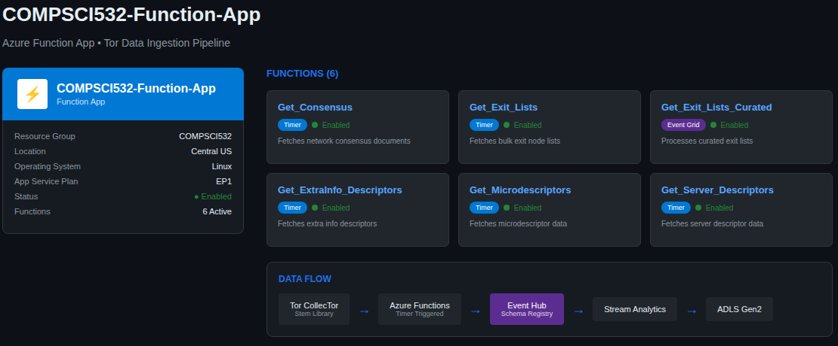
Design Description - Part 2

Slide 4
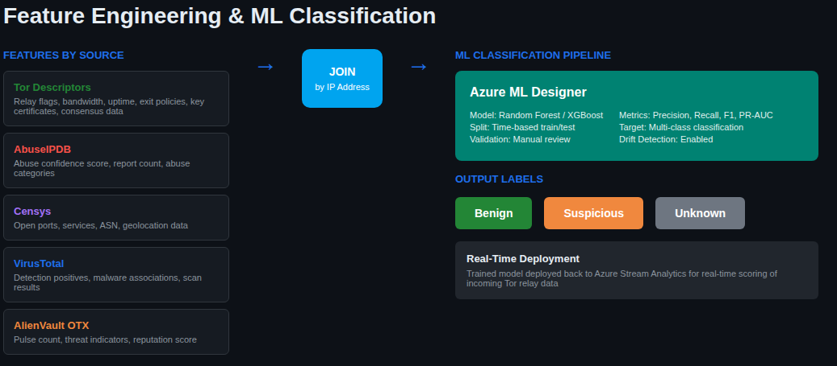
Design Description - Part 3

Slide 5
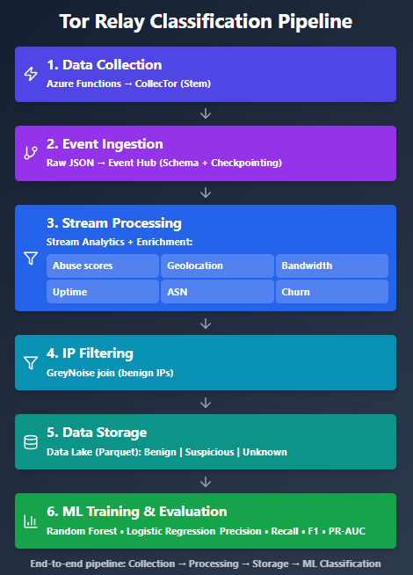
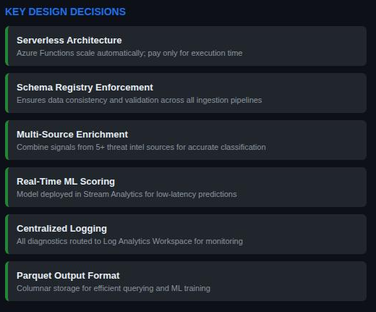
Design Description - Part 4

Slide 6
Tests
Sanity Checks on Each Azure Function: Verified each Azure Function returned valid JSON from TI APIs and matched expected enrichment fields (scores, geolocation, CVE flags) before sending to Event Hub
Pipeline Behavior Checks: Observed predictable scaling (larger daily pulls → longer processing time). Verified that Stream Analytics correctly joined tables (Tor data + enrichment data) by checking joined rows in Data Lake
Unit-Level Logic Tests: Ensured each function handled time-based triggers, API failures, and retries without crashing. Validated caching and rate-limit behavior for APIs such as VirusTotal, AbuseIPDB, and AlienVault OTX
Model Checks: Confirmed preliminary classifier produced expected label distributions (benign / suspicious / unknown).

Slide 7
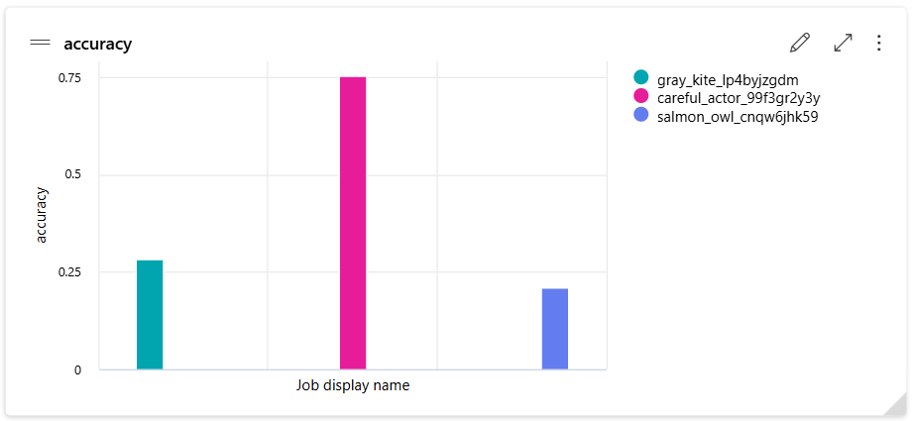
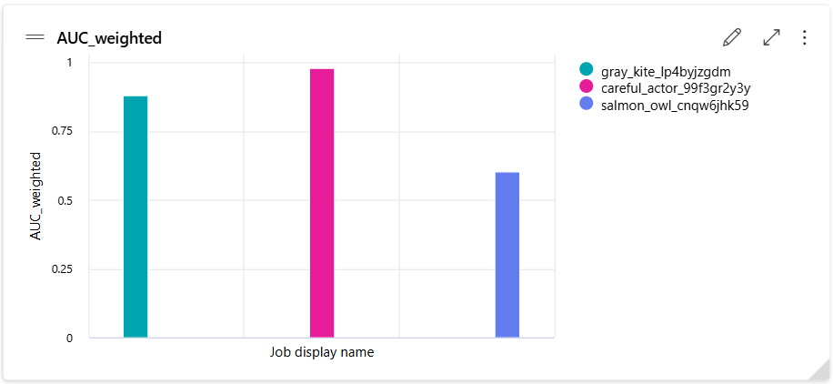
Experimental Results

Slide 8
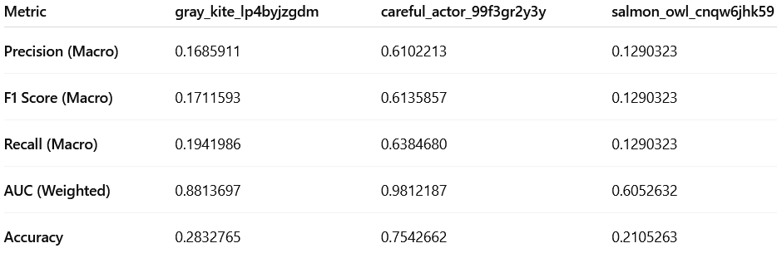
Experimental Results - Part 2

Slide 9
Goals
COMPLETE - Data ingested from all threat-intelligence sources (Tor descriptors, AbuseIPDB, Censys, VirusTotal, AlienVault OTX) via Azure Functions to Event Hubs
COMPLETE - Azure Stream Analytics jobs configured and processing all incoming data streams
COMPLETE - All processed data stored in Azure Data Lake Storage Gen2
COMPLETE - ADLS Gen2 containers mounted as data stores in Azure Machine Learning
COMPLETE - Diagnostics from Azure Functions, Event Hubs, Stream Analytics, and ADLS routed to Log Analytics
COMPLETE - Tor Bulk Exit Lists and Bandwidth Files added to Tor ingestion pipeline
COMPLETE - Multi-source join of Tor, Censys, and AbuseIPDB data in Azure Stream Analytics
COMPLETE - Machine-learning model created and deployed in Azure ML Designer
* updated goals approved Piazza @194

Slide 10
Incomplete Goals and Possible Improvements
Possible Improvements
Add more threat intelligence sources (GreyNoise, EPSS, CISA KEV, MaxMind) to enhance classification accuracy
Implement model drift detection in Azure ML to monitor classifier performance over time
Add real-time alerting via Azure Logic Apps when high-confidence malicious nodes are detected
Create an interactive Power BI dashboard for visualizing threat intelligence trends and model predictions
Implement incremental training to update the ML model as new labeled data becomes available
Implement A/B testing framework to compare different ML models (Random Forest vs XGBoost vs DNN)
Add historical churn analysis to detect relays that frequently appear and disappear

